Slide 1
BPMS Live
BPMS for LAM Research Projects
(Referral Bonus)
ProGear Id - GB_BPMS_LV-000888
Sep’2020
Vivek Singh(OHR: 703212151)

Slide 2

BPMS Live ► 7 Step Methodology
BPMS Live - The 7 Step Methodology
Building Process Framework
Customer VOC
Defining Project Charter
ARMI
Project Schedule/Plan
COPIS
Define
Operational Excellence Risk Assessment
Failure Mode and Effect Analysis
Finalizing (Input, Process, Output) Metrics
Finalizing Metrics Framework
Define Operational definitions of metrics
Client sign off on metrics framework
Set Up Measurement System
Data Collection Plan
Root Cause Analysis Calibration – Suggestions for Improvements
Analyze
Setting Up Reporting Structure
Governance Structure – Genpact and Lam Research
Structure of Report
Visual Management Standardization
Visual Management ( service now)
Closure
Continuous Improvement Roadmap
Control Plan
Way Forward
Standardization of Review Process

Slide 3
BPMS Live ► 7 Steps
Step Name | Objective | Acceptance Criteria | Tools
1. Building Process Framework | Business Case Process Criticality and Project Schedules | Holistic Business Case with clear framework outlined for the project Customer VOC to be shared | Customer VOC Project Charter, ARMI Project Schedule COPIS
2. Operational Excellence Risk Assessment | Operational FMEA | Incorporation of Operational FMEA | Operational FMEA model
3. Finalizing (input/process/output) Metrics | Identify Input-Process-Output measures | Finalizing Metrics Framework Define Operational definitions of metrics Client sign off on metrics framework | Matrices Framework Operational Definition Client Signoff
4. Set-up Measurement System | Create Data Collection Plan Perform Calibration | Set up Process for data collection Check for Operational and Calculation Definition of Metrics Rigor on Measurement System Analysis and Calibration | Data Collection Plan & Templates Calibration
5. Setting up Reporting Structure | Analysis of Metrics Governance Structure Reporting & Dashboard automation Implementation | Baselining and analysis of metrics Automating of reports & Dashboards Pilot Implementation Full scale implementation | Metrics Dashboard Implementation Plan
6. Visual Management Standardization | Visual Management to be implemented Organizing GEMBA Walk | Visual display of metrics on floor | VM Tools GEMBA
7. Continuous Improvement Roadmap | Create a line of sight for Transformational initiatives and changes | Identify Improvement opportunities CI roadmap Sign off and Closure | Transformation Road Maps Client Signoff
Corporate Panel Assessment – Mid Review for Initiation and Analyze
Corporate Panel Assessment – Final Review for Closure

Slide 4
Step 1
Build Process Framework

Slide 5

Voice Of Customer
What we heard from you …
Set up Quality System for LAM research Projects
– When an employee refers a candidate and the candidate is hired and completed 30 days of service then the employee who referred him should receive a bonus payout. We are doing this activity manually can we automate this.
VOC: Nancy Alens
Director, HRIS, HR Operations LAM Research
Develop Integration Process
VOC: Sam Bhadra
Snr HRIS Program Manager, HR Operations LAM Research
VOC: Sasikiran
Assistant Vice President, Operations Genpact
Notes:
Commodities and Global Markets

Slide 6

Customer Information
Customer Info | Particulars
Brief Customer Description | Lam Research Corporation is an American corporation that engages in the design, manufacture, marketing, and service of semiconductor processing equipment used in the fabrication of integrated circuits. Its products are used primarily in front-end wafer processing, which involves the steps that create the active components of semiconductor devices (transistors, capacitors) and their wiring (interconnects). The company also builds equipment for back-end wafer-level packaging (WLP), and for related manufacturing markets such as for microelectromechanical systems (MEMS).
Global customer delivery centers and Product lines | Lam Research headquartered is in Fremont, California, in the Silicon Valley. As of 2018, it was the second largest manufacturer in the Bay Area, after Tesla.
Association with Genpact in terms of verticals and business | Lam Research engagement is aligned to HMS GC vertical and is operated by Platforms service line
Customer Logo

Slide 7
Process Charter
The referral bonus for an employee is updated in EC manually based upon the criteria that the referred employee have completed 30 days in the organization. This is a time-consuming task and it takes some man hours to update the referral bonus and date calculations (Employees who have completed 30 days in the organization). An automation solution is proposed through integration. The solution checks for the employees who has completed exactly 30 days in the LAM and automatically inserts the referral amount to person who refer the employee in the Compensation portlet rather than manually inputting the amount
Business Case
Process Criticality
This is a new engagement deployment at Genpact and we are in process of implementing the automated process through integration. It helps in reduction of human errors in updating the referral amount.
Key Project Deliverables
Robust Process for Referral Bonus.
Integration Process.
Process TDD.
In scope: SAP Succesfactors Referral Bonus process under Lam Research.
Out of Scope: Non US employees are OUT of Scope in Automated process.
Boundaries
Project Team
Lead | Mentor & Master Coach | QL
Vivek Singh | Shalini Akunur | Deepak Chopra

Slide 8
ARMI
Stakeholder | Role | Responsibility
Nancy Alens | Director, HRIS, HR Operations - LAM Research | A,I
Sasikiran | Sponsor- Genpact | A, I
Piush Goyal | VP, Capital Markets Platforms - Genpact | I
Deepak Chopra | Quality Leader | A
Shalini Akunur | Mentor & Master Coach | A
Mathur Dheeraj | Master Black Belt | R, A
Vivek Singh | Project Lead | M
Akshay Jain, Satya Gunuru, Baradwaja Angeerasam, Sam Bhadra | Project Team | M
Approval of team decisions outside their charter authorities, i.e., sponsor, business leader
Resource to the team, one whose expertise, skills, or clout may be needed on an ad-hoc basis
Member of team, with the authorities and boundaries of the charter
Interested party, one who will need to be kept informed on direction, findings, if later support is to be forthcoming

Slide 9
Project Schedule
Planned
In Progress
Completed
Jan’ 2020 | Feb’2020 | Mar’2020 | Apr’2020 | May’2020 | Sep’2020 | Oct’2020
Share requirements for Automation to EC and RCM Modules
Complete all the analysis
Complete the Boomi Development
Complete all the testing and reviews
Send for production deployment Approval
Parallel run / Go Live
Phase |  | Planned Start Date | Planned End Date | Actual Start Date | Actual End Date
Define | Share requirements for Automation to EC and RCM Modules | 01-Jan-2020 | 28-Jan-2020 | 01-Jan-2020 | 28-Jan-2020
 | Complete all the analysis | 29-Jan-2020 | 28-Feb-2020 | 29-Jan-2020 | 28-Feb-2020
 | Complete the Boomi Development | 02-Mar-2020 | 15-Apr-2020 | 02-Mar-2020 | 15-Apr-2020
Review/Testing | Complete all the testing and reviews | 16-Apr-2020 | 15-May-2020 | 16-Apr-2020 | 15-May-2020
 | Send for production deployment Approval | 16-May-2020 | 28-Sep-2020 | 16-May-2020 | 28-Sep-2020
Closure | Go Live | 29-Sep-2020 | 30-Oct-2020 | 29-Sep-2020 | 30-Oct-2020

Slide 10
Communication Plan
Event | Responsibility | Message | Audience | Frequency | Date
Kick Off Meeting | Vivek Singh | Discussion on project Initiation | Snr HRIS Program Manager, HR Operations - LAM Research AVP, Capital Markets Platforms – Genpact; Mentor; | One time | 01-Jan-2020
Governance Call | Vivek Singh | Progress Updates | Snr HRIS Program Manager– Lam Research Mentor; Project Team | Monthly | Feb’2020 Onwards
BB Status Meeting | Vivek Singh | Discussion on project progress | Mentor; Project Team | Weekly | Ongoing
Phase Completion Review | Vivek Singh | Discussion on project Phase completion | Mentor; Master Coach | Phase Completion | May’2020; Jun’2020; Jul’2020
Panel Review | Vivek Singh | Project review | Mentor; Master Coach; Quality Leader | One time | Jul’2020; Oct’ 2020

Slide 11
Benefits from Project
The Potential benefits from the project delivered with the implementation of BPMS Live would be focused on:
Automation solution removes /reduces the human error in updating the referral amount.
Man hours spent within Business and Genpact HRIS Team will be significantly reduced.

Slide 12
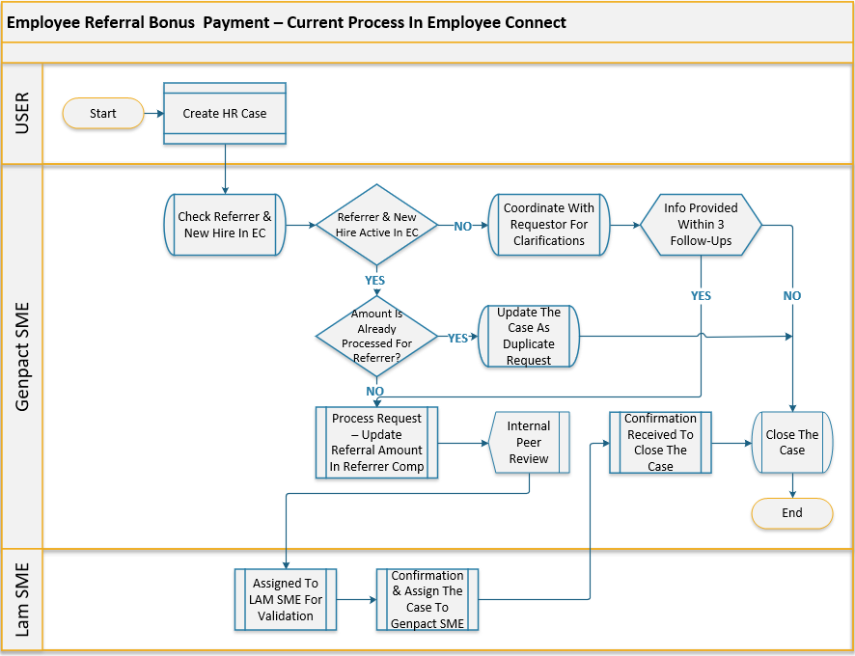
Document Process COPIS
Customer
Output
Process
Input
Supplier
Referral Amount Update
HR Cases
Lam Research
Product Consultant
Lam Research

Slide 13
Step 2
Operational Excellence Risk Assessment

Slide 14
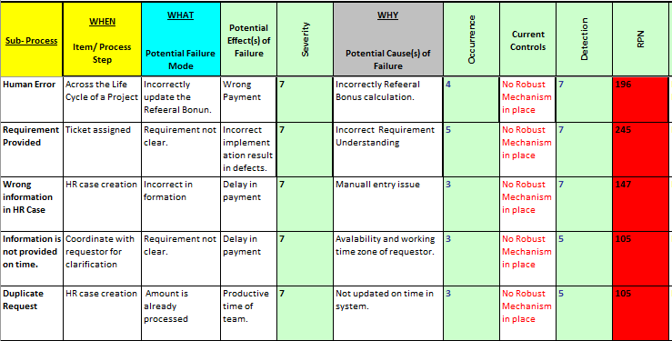
Risk Assessment – Failure Mode and Effect Analysis

Slide 15
Step 3
Finalizing (Input, Process, Output) Metrics

Slide 16
Finalizing (Input, Process, Output) Metrics
Input Measures
Process Measures
Output Measures
All regular Employee with hire date equal to current date – 30.
Number of Incident Received.
Process Reporting
Grant the Referral Bonus to eligible employee and send email notification.

Slide 17
Operational Definition for Metrics
S. No | Metric Name | Operational Definition
1 | Number of Incident Received | Average number of Referral Bonus HR cases received in a month.
2 | Process Reporting | Error frequency in the automated process.
3 | All regular Employee with hire date equal to current date – 30. | New hire regular employees who serve 30 days in an organization.
4 | Grant the Referral Bonus to eligible employee and send email notification. | Add the bonus to the eligible employee compensation portlet.

Slide 18
Step 4
Set Up Measurement System

Slide 19
Data Collection Plan
Measure Name | Description
What | Total no of tickets generated in the form of Incidents
When | Jan 2020 – Oct 2020
Where | Excel .CSV file
How | Downloaded the tickets created data from Service-Now ticketing tool
Who | Vivek Singh
Sample Size | 100% of tickets

Slide 20
Root Cause Analysis Calibration – Suggestions for Improvements
Suggested Enhancements:
Automated the process having repeated tickets hence reducing time efforts and human errors.
This is a one-time improvement and not recurring in nature.
Defect Root Cause Categories that can be added:
  Code Issues
  Performance Issues
  Understanding Gap
Suggested RCA Categories and RCA Components
RCA Category | RCA Component
Code Issue | Project Configuration; Roles and Permission; Integrations - Application;
Requirement Gap | Artefacts Mismatch; Functional Understanding; Document Mismatch
Product Issue | Product Documentation; Product Configuration;
RCA Category | RCA Component
Data | Input Test Data
Environment | Upgrades; Connectivity
Performance Issue | Product Configuration; Product Customization;
Understanding Gap | Incorrect Execution; Requirement Understanding

Slide 21
Step 5
Setting Up Reporting Structure

Slide 22

Governance Structure – Genpact and Lam Research
Sasikiran
Assistant Vice President, Operations
Piush Goyal
VP, Capital Markets Platforms
Deepak Chopra
Quality Leader
Vivek Singh
Project Leader
Monthly Management Review
(Monthly)
Review progress against agreed priorities
Data Analysis for current releases
Review operational performance and Dashboard
Genpact will work with Lam Research team to drive best practices/benchmarking
Level 2
(BI-Monthly)
LDT Team
Ops Team
Weekly Service Delivery
Data collection for recent releases
Review operational performance and Dashboard
Highlighting issues / concerns
Project Progress Updates
Sampath Kareddy
Project Leader
Shalini Akunur
Project Team
Akshay Jain, Satya Gunuru, Baradwaja Angeerasam, Sam Bhadra
Level 1

Slide 23
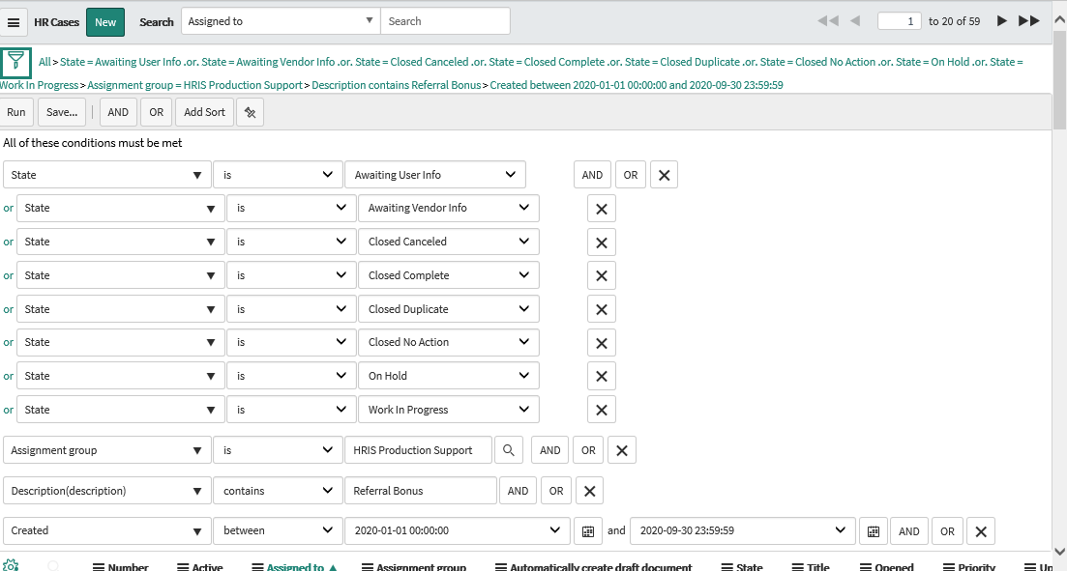
Structure of Report
Filters Used in the Report
The source of the Requests is through automated channel
State of the ticket
Filter all the Referral Bonus ticket
Created in year 2020

Slide 24
Step 6
Visual Management Standardization

Slide 25
Visual Management ( service now)
This report showcases the total no of Service Requests created before and after the automation.

Slide 26
Step 7
Continuous Improvement Roadmap

Slide 27
Control Plan
 | Work Plan | Checking the work done |  | Action to be Taken | Responsibility
S.No. | Activity | Output Measure | Frequency | Action to be taken | Responsibility
1 | Monthly / Quarterly Audits | No of tickets created | Monthly / Quarterly | Reporting to the Client | Vivek Singh
2 | Configurations (Add/ Modify/ Delete) | Change Management Request, Operational Requirements | Need Basis | Development / Testing / Implementation Required | Vivek Singh/ Service-Now Development
3 | Access to Reports | Access to be granted to the requesters | Need basis | To provide access of the reports which depicts the no of service requests. | Vivek Singh

Slide 28
Way Forward
As a Way Forward following enhancements can be looked upon by Lam Research Team:
International transfers - Country specific fields are not auto populated in SF.

Slide 29
Standardization of Review Process
Business Case:
When an employee is transferred from one country to other country (International Transfer), country specific fields of target country which are to be auto populated are not being updated on screen.
Ex: While an employee is being transferred from Austria to United States, fields like “US FLSA Status, EEO Category etc” which are mandatory for USA employees are not getting displayed/autopopulated.
Proposed Solution :
In discussion with SME.
  Potential Impact
  Effort Saving – User creates a ticket every time there is a country transfer of an employee and this is assigned to HRIS to update the data after transfer is done. With this enhancement, when employee is transferred between countries, country specific fields gets displayed automatically and this saves the time in creation and manual update after transfer.

Slide 30
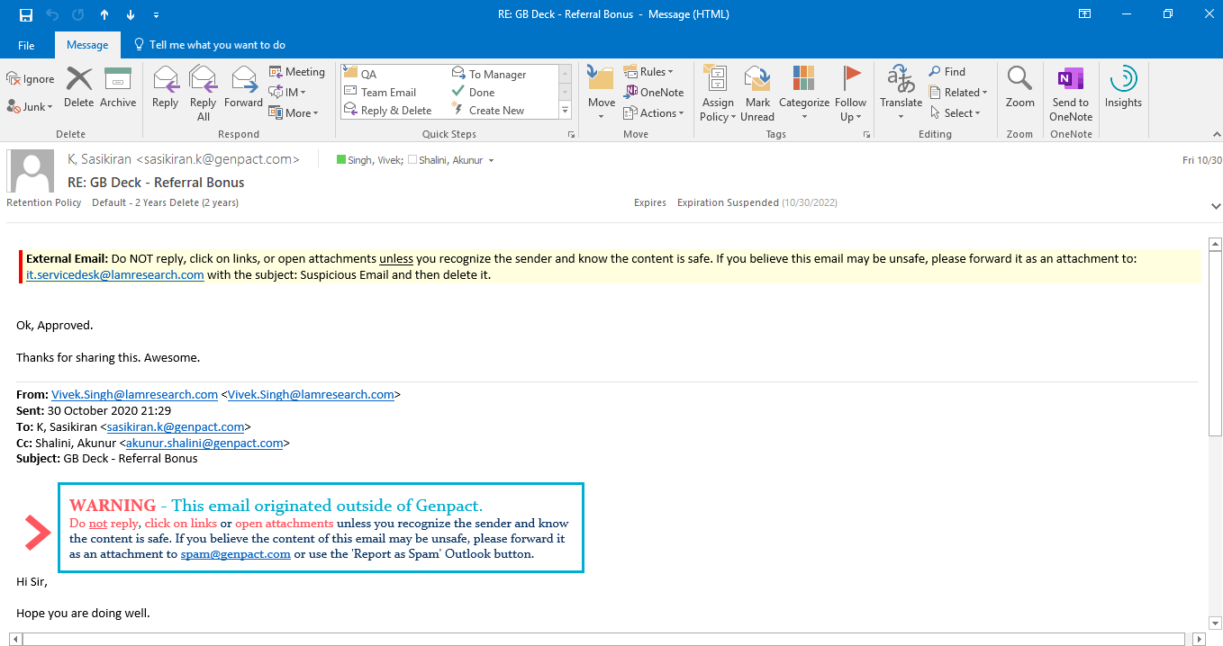
Approval

Slide 31
Thank You

